Slide 1
The Fundamental Theorem of Calculus
Wednesday 21st September, Culverhay, Newton Project

Slide 2
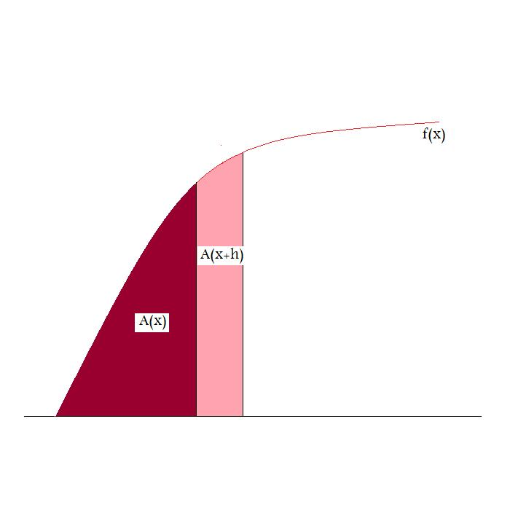
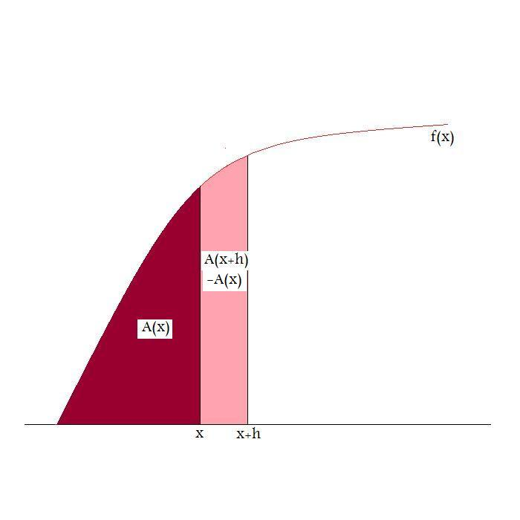
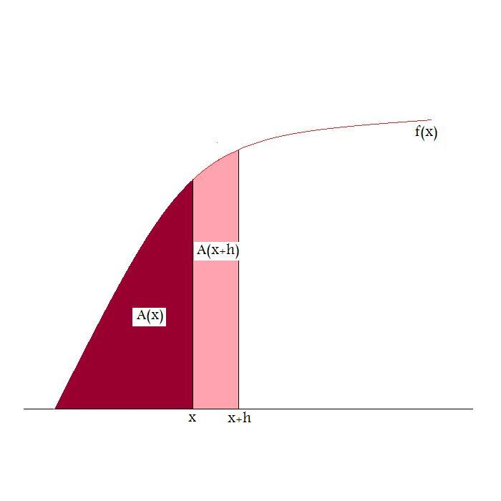
We have talked about differentiation and integration. The fundamental theorem of
calculus connects these ideas. Consider the following diagram;

Slide 3
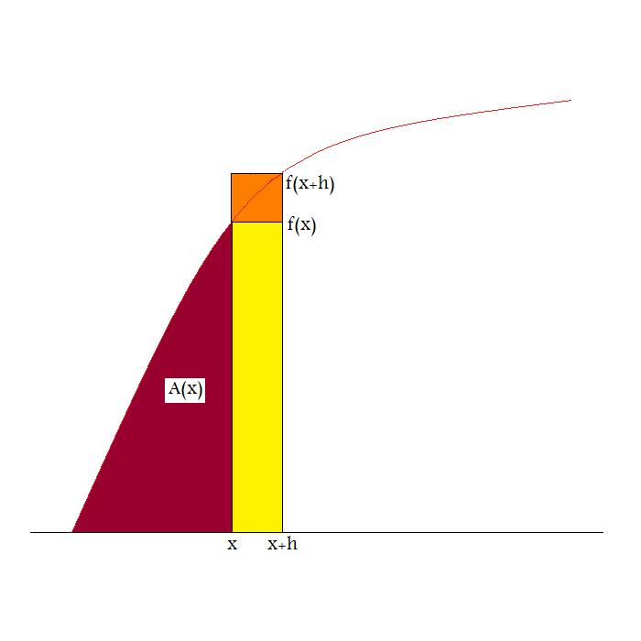
The function A(x) measures the area under the curve f(x). We are interested in what
happens, as the ordinate x advances to x+h, and the area changes to A(x+h). The pink
region measures the difference in areas A(x+h)-A(x). Observe that the pink region is
bounded in area below by the yellow region and bounded above by the yellow+orange
region in the following diagram;

Slide 4
Hence, we have the following inequalities;
Combining the inequalities and dividing by h, gives us that;
Finally, taking the limit as
and using the definition of the derivative, we obtain that;

Slide 5
We can restate this result using the definition of integration;
We say that A is an antiderivative of f. If B is another antiderivative of f, then
A=B+c, where c is a constant. As A(a)=0, we have that c=-B(a).
What is the area under a curve f(x) as the ordinate advances from a to b?
Answer; By definition, A(b)=B(b)+c=B(b)-B(a)

Slide 6
We can summarise this in the following version of the fundamental theorem of
calculus;
Isaac Newton gives the first proof of this result in his unpublished paper “The
Calculus Becomes an Algorithm”, written in 1665. He uses a different geometric
method, which you might like to read about, using the resource “An Interpretation
of Newton’s Work in Calculus”, available at http://www.magneticstrix.net The
argument I have given can be found in a very simplified form in Newton’s paper,
“Analysis of Equations of an Infinite Number of Terms”, written in 1669, a published
Version (in Latin) appearing in1711, and a translated published version appearing in
1745. On the following slide, you can see an excerpt from “De Analisi”.

Slide 7
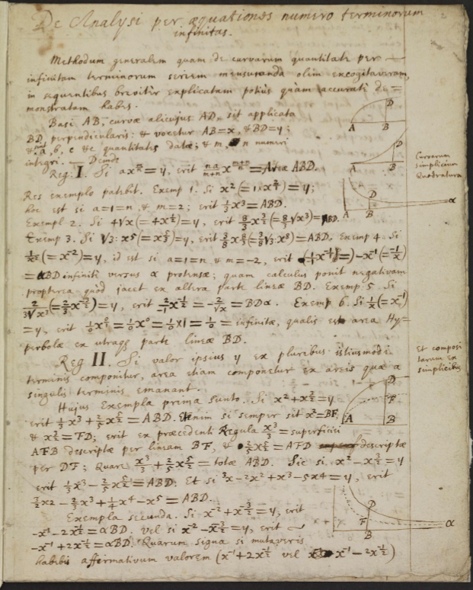

Slide 8
The contents of this paper was the centre of the later dispute as to whether Liebniz
had obtained the idea of the differential calculus from Newton, previous to Liebniz’s
publication of 1684. However, it is interesting to note that in Liebniz’s “Excerpta from
Newton’s De Analisi”, October 1676, he makes no comment whatsoever on the
passage which deals with the Fundamental Theorem of Calculus. Given the lack of
justification in certain steps of Newton’s argument, it seems reasonable that Liebniz’s
formulation of a rigorous definition of integration and differentiation, using infinitesimals,
was a genuine independent achievement. This last conclusion is similar to that which
Charles Bossut gives in “A General History of Mathematics from the Earliest Times to
the Middle of the Eighteenth Century” (1802)
“All of these considerations appear to me to evince that, if the piece De Analisi per
Aequationes and the letter of 1672 contain the method of fluxions, it was at least
enveloped in great darkness”
(The letter referred to is one that Newton wrote to Collins , claiming to have found a
general method of finding the tangent to a curve, but without giving any demonstration.
The method of integration is also obscure in the paper “De Analisi”. Given the arguments
in my paper, referred to above, that Newton had, by this stage, a full understanding of
the methods of calculus, it seems likely that this obscurity was deliberate.)

Slide 9
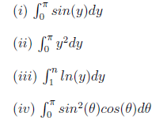
For practice, try computing the following integrals using the fundamental theorem of
calculus;
The third question uses a method known as integration by parts, the last question
involves integration by substitution.

