Slide 1
Integration
Newton project, Culverhay, Wednesday September 21st

Slide 2
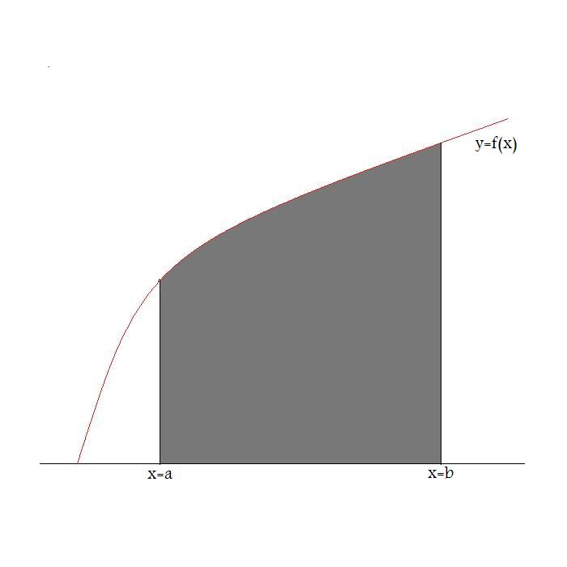
The idea of integration is to find the area under a curve between two ordinates
a and b;

Slide 3
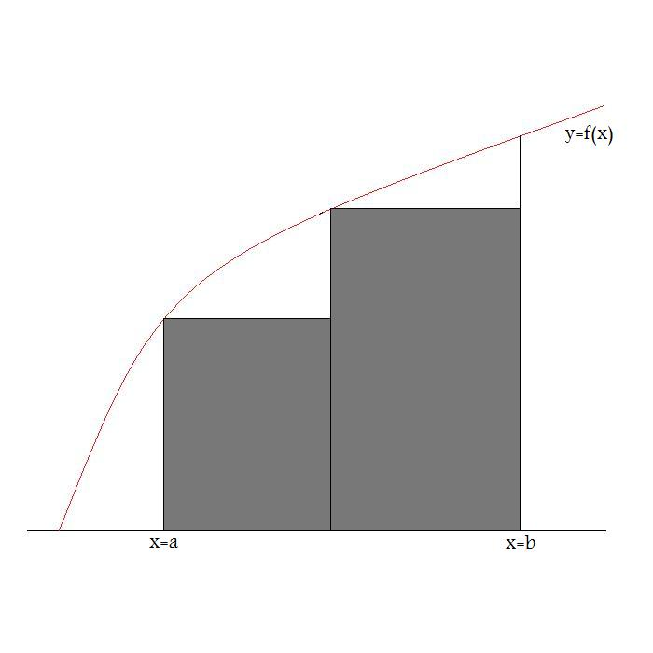
The way to do this is to approximate the area by a sequence of rectangles;

Slide 4
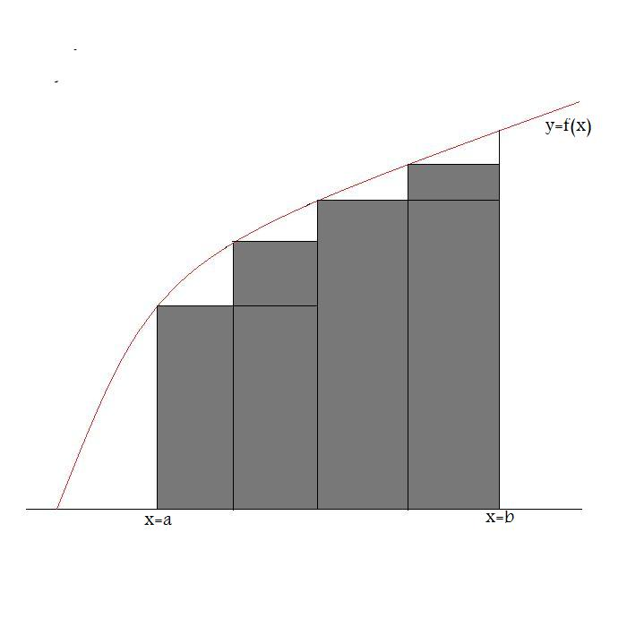
Notice, as the width of the rectangles decreases, we get a better approximation to the
area;

Slide 5
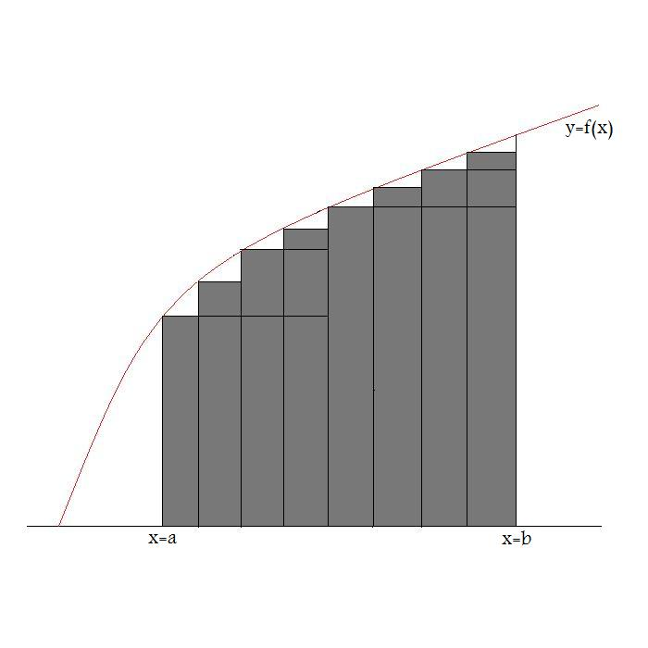
And that the areas under the rectangles increases;

Slide 6
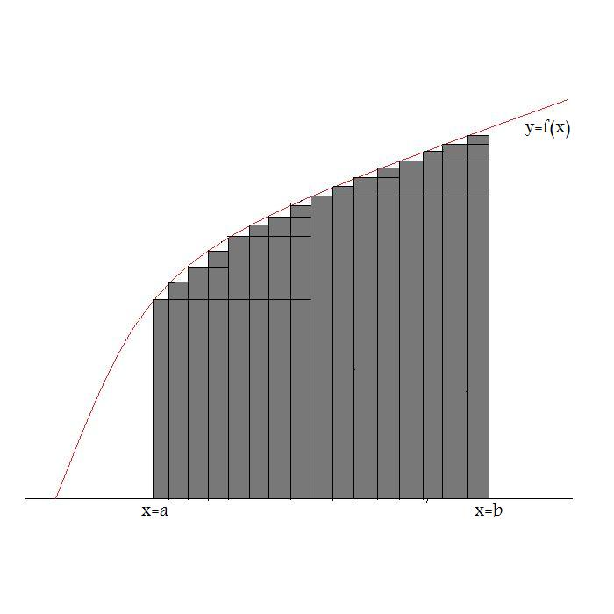
Finally, the rectangles converge to our original function f(x);

Slide 7
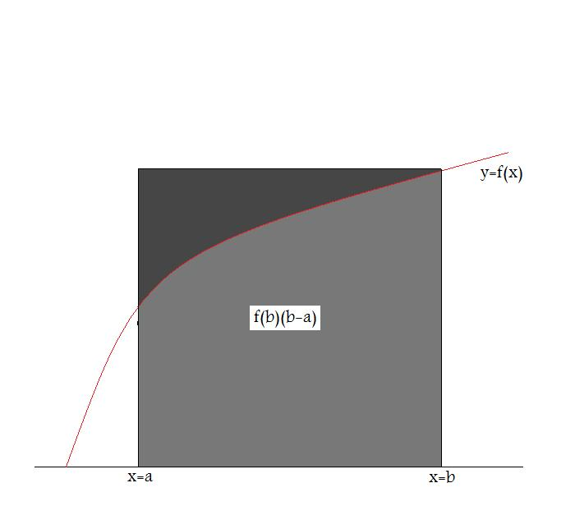
Observe that all the areas, under the rectangles, are bounded by the area under a
larger rectangle;

Slide 8

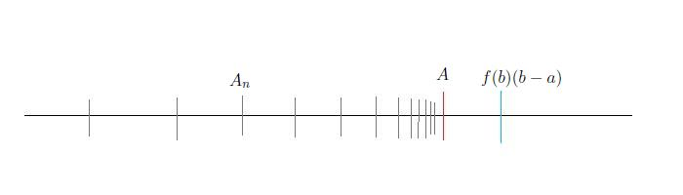
If we divide [a,b] into n intervals of width
then the total area under the rectangles is given by;
By subdividing each rectangle into halves, at each stage, as shown in the slides, the
sequence of areas increases. Moreover, the areas are all bounded by the amount
We thus obtain a bounded sequence of increasing real numbers. It is a property of
the real numbers, that such a sequence has a limit A, the area under the curve.

Slide 9
More technical questions to consider;
(i). Why does the sequence of areas increase, in this example. Can I always refine my
partition and define rectangles with this property?
(ii). What property of the function, f , ensures that the sequence of rectangles
converges to f?
(iii). If I choose a different sequence of rectangles, am I guaranteed to obtain the same
limit, the area under the curve?
The reader interested in doing some independent reading, should look at a textbook
on integration to resolve these questions. I would recommend Chapters 1-3 of
“Lebesgue Integration and Measure”, by Alan Weir, (CUP).

